Slide 1
Building a Web App with Blazor and ASP.NET Core

Slide 2
Objectives
Understand Blazor Basics
Key Features
Hosting Models Comparison
Blazor Component
Build a Blazor Web App
Build a Blazor Web App with Entity Framework Core

Slide 3
What is Blazor?
Blazor is a framework for building interactive web UIs with C# instead of JavaScript.
The name Blazor comes from "Browser" + "Razor" (the .NET templating engine).
It supports two hosting models:
Blazor Server: Runs on the server, with UI interactions handled over a SignalR connection.
Blazor WebAssembly (WASM): Runs entirely on the client, compiled into WebAssembly.

Slide 4
Blazor Key Features
C# Everywhere: Write client and server code in C#.
Reusable Components: Build UIs using components that can be reused across pages and projects.
Full-Stack .NET: Share libraries, models, and validation logic between the client and server.
Dependency Injection: Built-in support for dependency injection to manage services.
Routing: Built-in routing support for creating Single Page Applications (SPAs).

Slide 5
ASP.NET Core Blazor
ASP.NET Core Blazor is an open-source web framework for building interactive web UIs using C# and HTML.
Purpose: It enables developers to create single-page web applications (SPA) with rich interactivity and real-time updates.
Key Features:
Utilizes WebAssembly to run C# code in the browser.
Supports both client-side (WebAssembly-based) and server-side rendering models.
Provides a component-based architecture for building reusable UI components.

Slide 6
ASP.NET Core Blazor
ASP.NET Core Blazor is a powerful framework for building interactive web UIs using C# and HTML.
Blazor has gained traction among developers for its simplicity, productivity, and flexibility.
Microsoft continues to invest in Blazor, with ongoing updates and improvements to the framework and tooling.

Slide 7
Two Rendering Modes in Blazor
Client-side Rendering:
C# code runs in the browser via WebAssembly.
Entire application is downloaded to the client's browser and executed locally.
Suitable for scenarios requiring offline support or when server interaction is minimal.
Server-side Rendering:
C# code runs on the server.
UI updates are sent to the client over a SignalR connection.
Reduces initial download size and supports older browsers.
Provides centralized logic and security on the server.

Slide 8
Hosting Models Comparison
Feature | Blazor Server | Blazor WebAssembly
Execution | Runs on the server | Runs in the browser
Performance | Low latency but requires a persistent connection | High latency for large initial download but no server interaction after load
Use Case | Internal apps, reliable networks | Offline-capable or public apps

Slide 9
Benefits of ASP.NET Core Blazor
Single Language: Developers can build entire web applications using C# and HTML, reducing the need for multiple languages.
Reusability: Components can be reused across different parts of the application, leading to code efficiency and consistency.
Full-stack Development: Blazor enables full-stack development with .NET, allowing developers to use the same language and framework for both client and server code.
Performance: Client-side rendering offers fast and responsive user experiences, while server-side rendering provides efficient resource utilization and scalability.

Slide 10
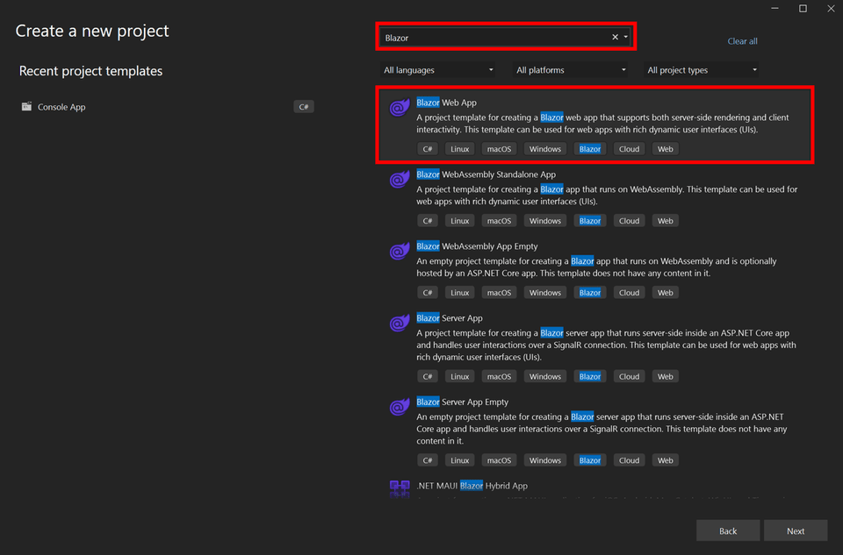
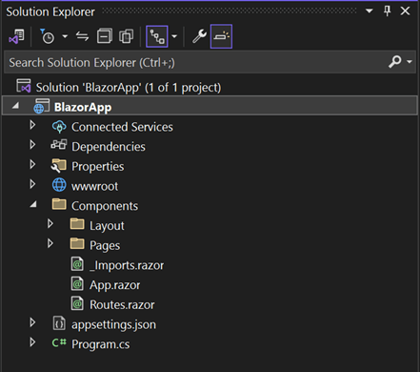
Build web app with ASP.NET Core Blazor

Slide 11
Build web app with ASP.NET Core Blazor
Program.cs is the entry point for the app that starts the server and where you configure the app services and middleware.
Inside the Components directory:
App.razor is the root component for the app.
Routes.razor configures the Blazor router.
The Pages directory contains some example web pages for the app.
BlazorApp.csproj defines the app project and its dependencies and can be viewed by double-clicking the BlazorApp project node in the Solution Explorer.
The launchSettings.json file inside the Properties directory defines different profile settings for the local development environment. A port number is automatically assigned at project creation and saved on this file.

Slide 12
Project Structure
A typical Blazor Web App consists of:
Pages Folder: Contains Razor components/pages (e.g., Index.razor, FetchData.razor).
Shared Folder: Holds shared components (e.g., NavMenu.razor).
wwwroot: Contains static files like CSS, JavaScript, and images.
_Imports.razor: Commonly used namespaces are declared here.
Program.cs: Sets up the application and configures services.

Slide 13
Blazor Component - 1
A Blazor Component is the fundamental building block of a Blazor application.
It represents a piece of the user interface (UI) in the form of reusable, self-contained code written using Razor syntax (a blend of HTML and C#).
Components are used to build dynamic, interactive web pages and applications in Blazor.
Basic Structure of a Blazor Component - A Blazor component is typically defined in a .razor file.
Once you create a component, can use it in other components or pages by referencing its name. If you created a component named MyComponent.razor, you can use it like this: <MyComponent />

Slide 14
Blazor Component - 2
Reusable UI Units:
Components can be used multiple times across different pages or projects.
They encapsulate the rendering logic and behavior.
Razor syntax allows you to combine HTML markup with C# code seamlessly.
Data can be passed into a component using parameters, allowing components to be more dynamic and configurable.
Components handle user interactions like button clicks and form submissions.
Components support one-way and two-way data binding to synchronize the UI with data.

Slide 15
Advanced Features of Components
Parent-Child Relationships
Components can have child components, and data can flow between them.
Cascading Values
Share data between nested components using cascading parameters.
Dynamic Rendering
Render components dynamically using RenderFragment.

Slide 16
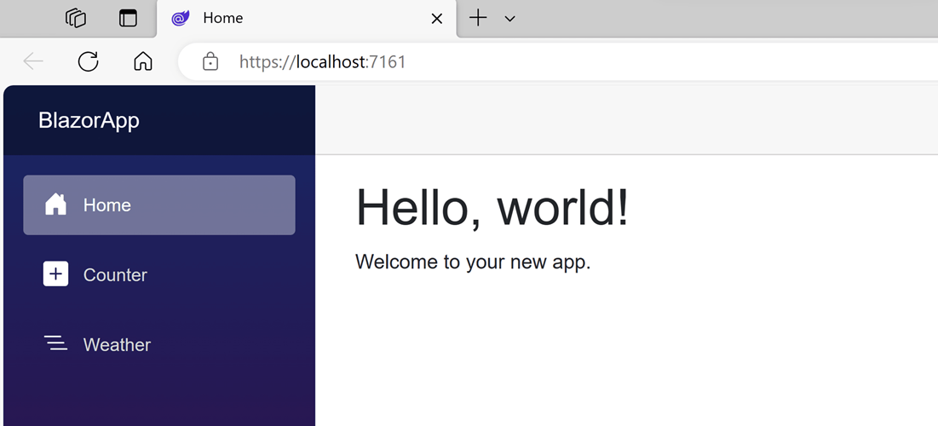
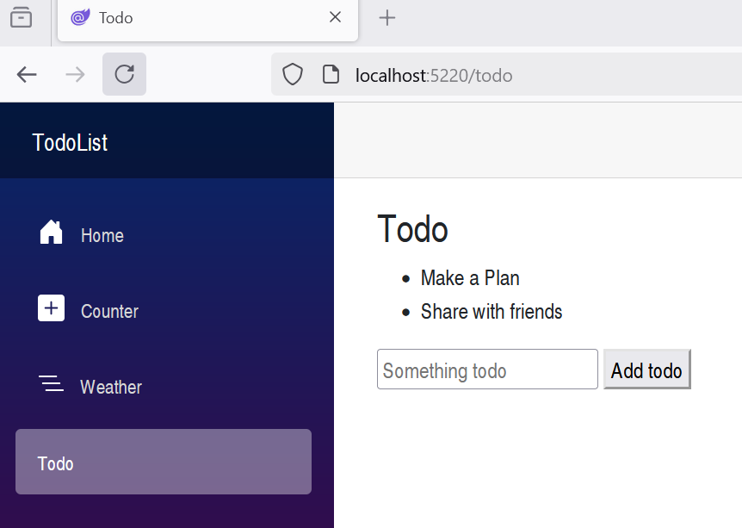
Build web app with ASP.NET Core Blazor

Slide 17
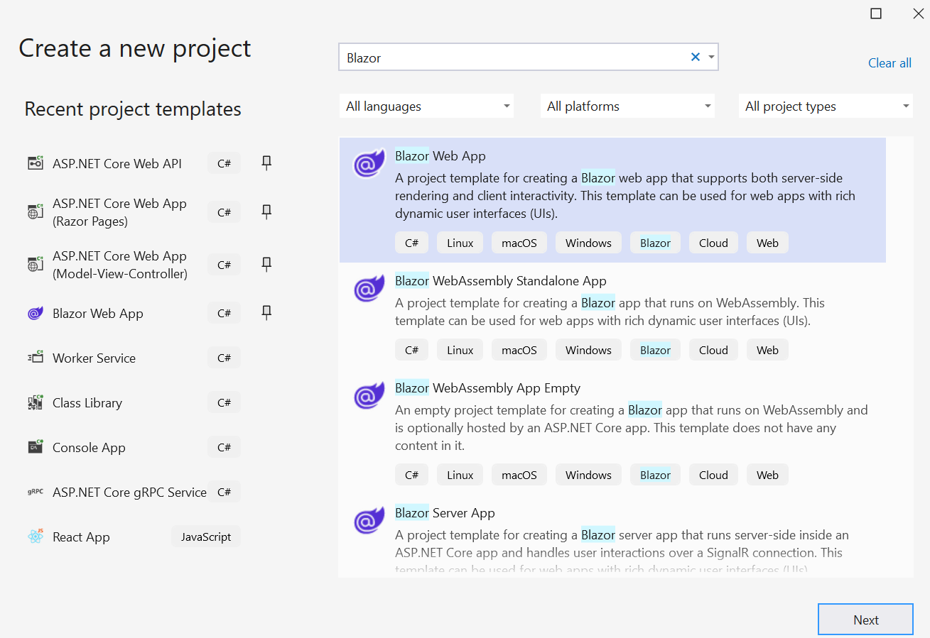
Build a simple Todo list with Blazor - 1
Choose Blazor Web App

Slide 18
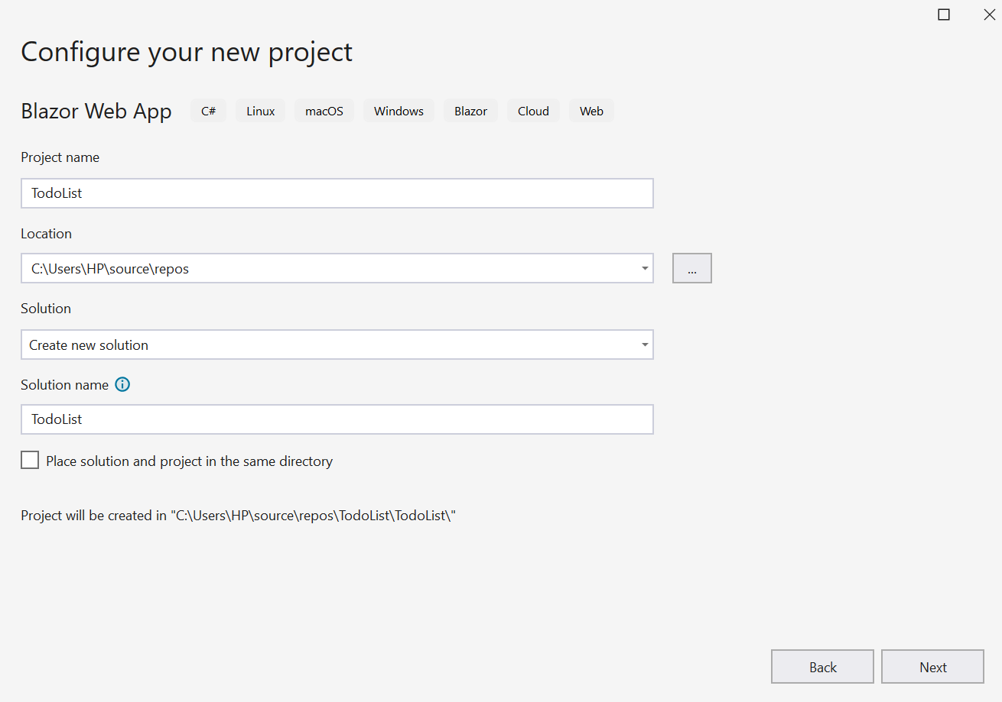
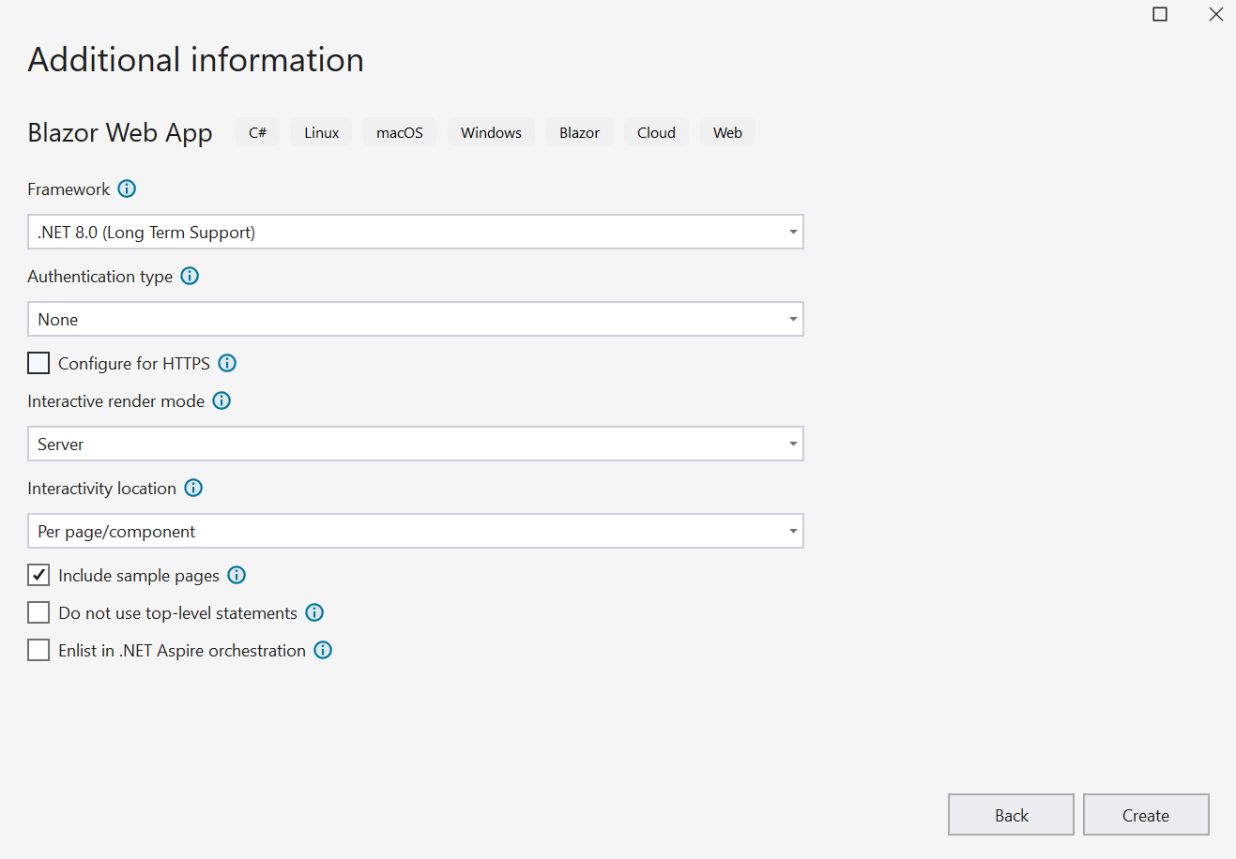
Build a simple Todo list with Blazor - 2
Choose .NET 8 Framework for Blazor Web App

Slide 19
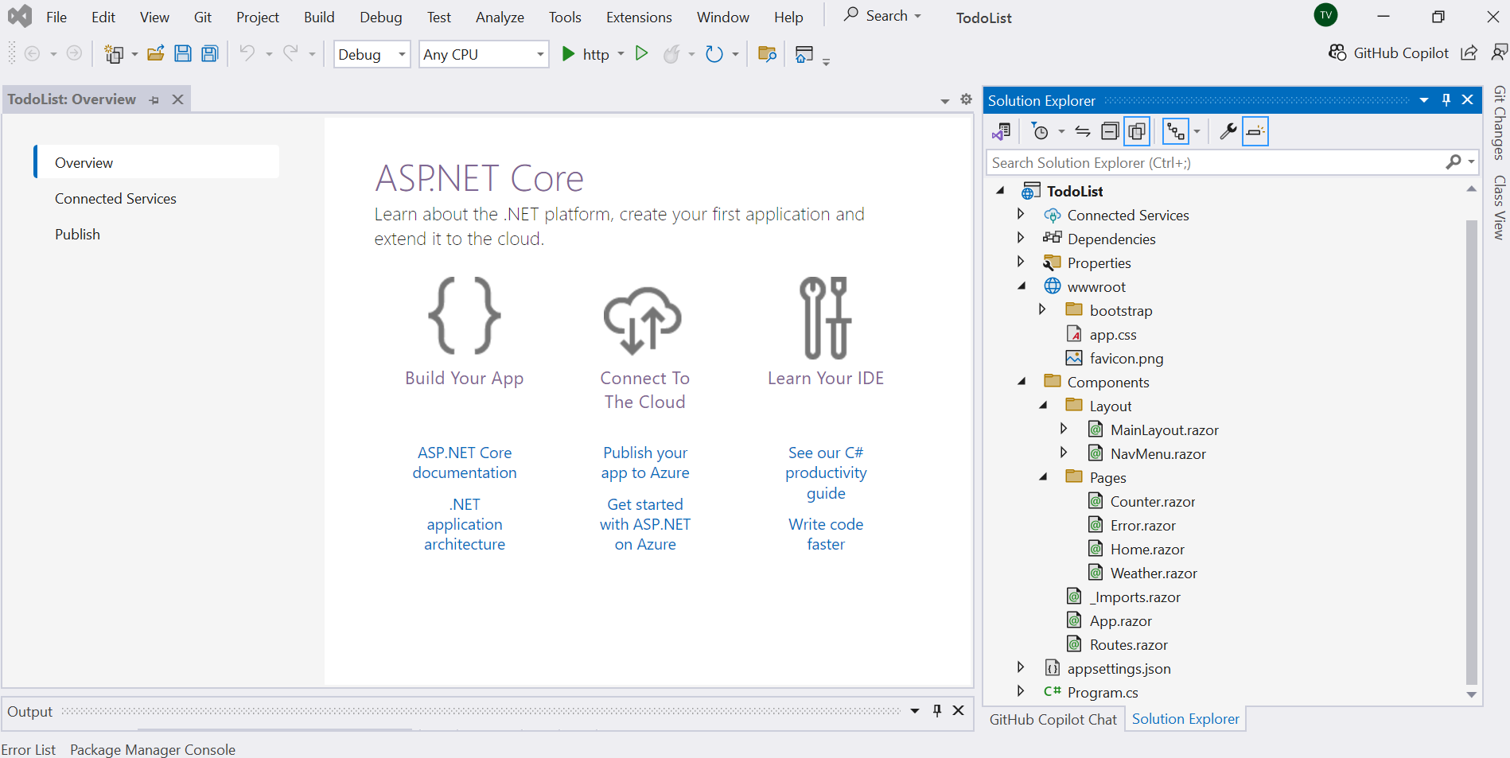
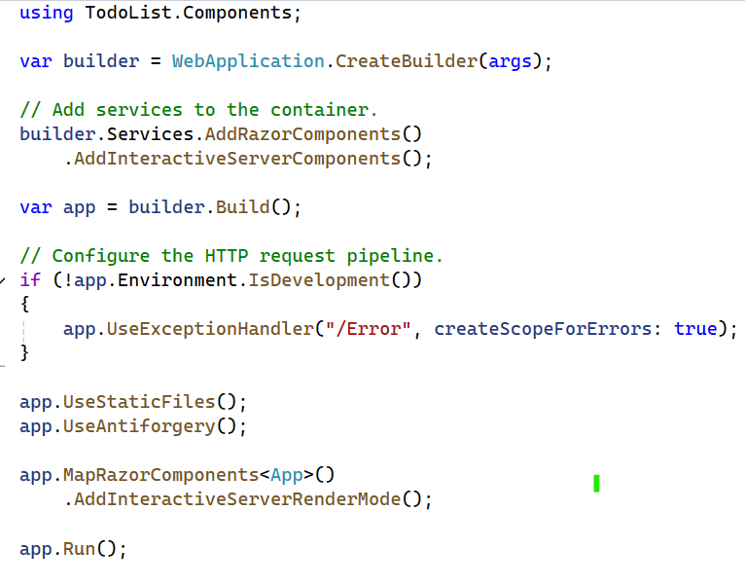
Build a simple Todo list with Blazor - 3
The Blazor Web App with wwwroot, Components and Program.cs

Slide 20
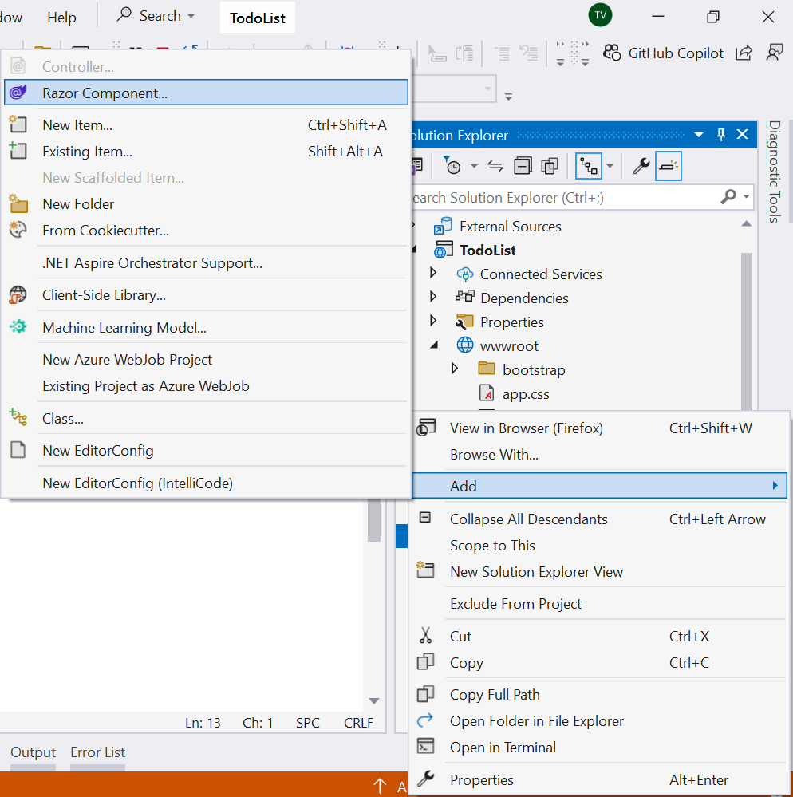
Build a simple Todo list with Blazor - 4
Add Razor Component

Slide 21
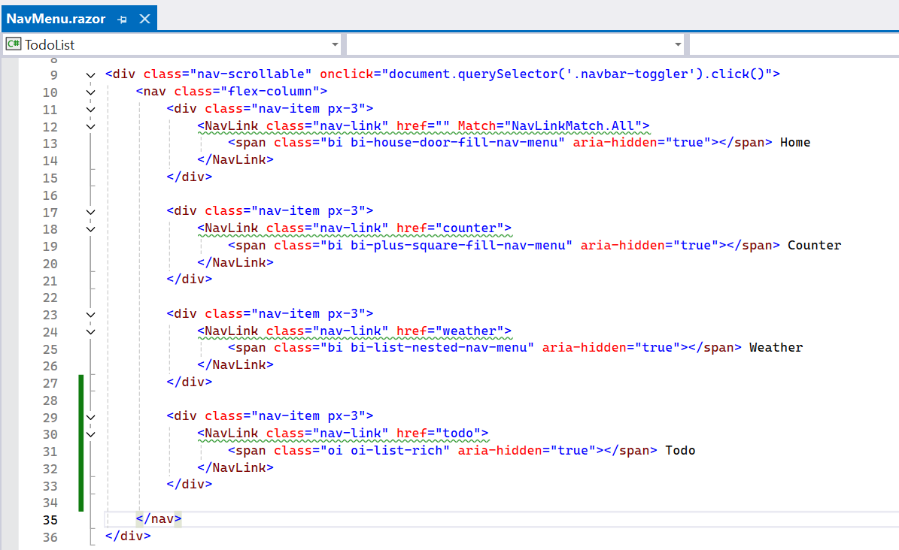
Build a simple Todo list with Blazor - 5
Add a menu item for todo function

Slide 22
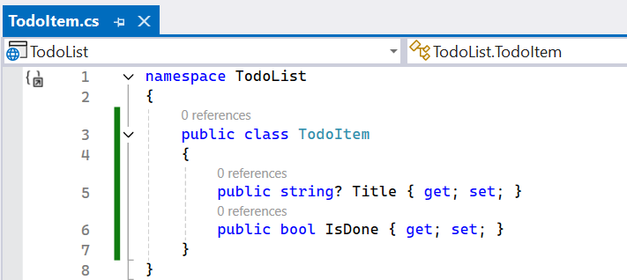
Build a simple Todo list with Blazor - 6
Add a menu item for todo function and create class TodoItem.cs

Slide 23
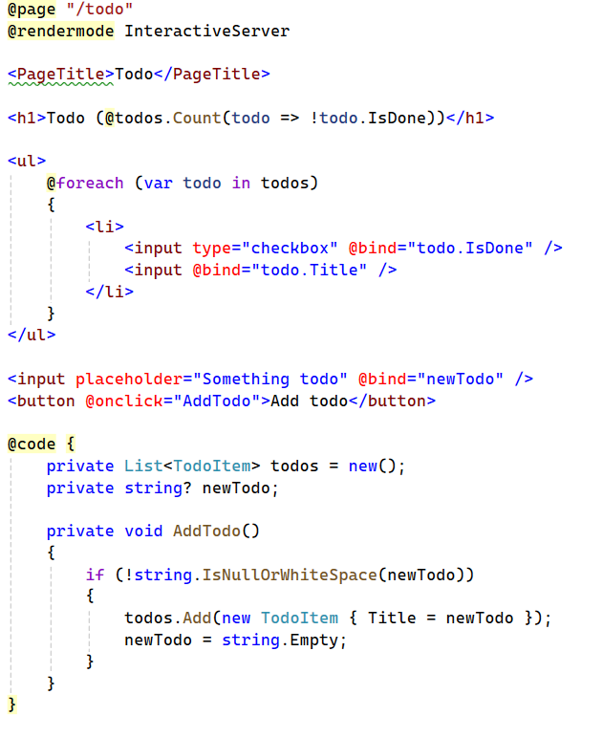
Build a simple Todo list with Blazor - 7
Add an AddTodo method to the Todo component and register the method for the button using the @onclick attribute.
The AddTodo C# method is called when the button is selected.

Slide 24
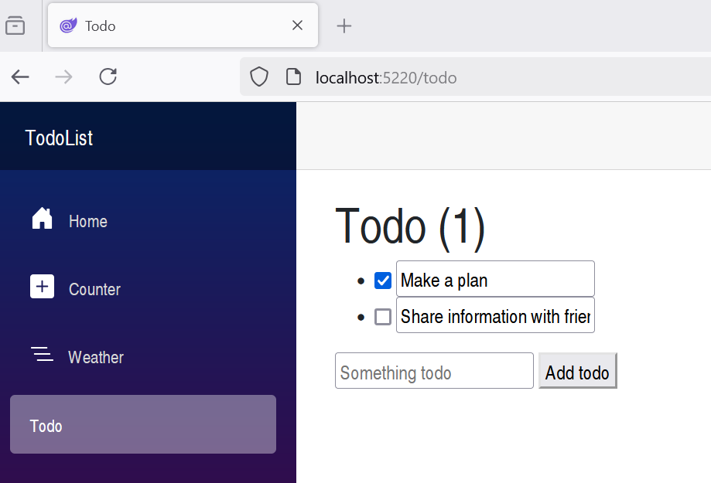
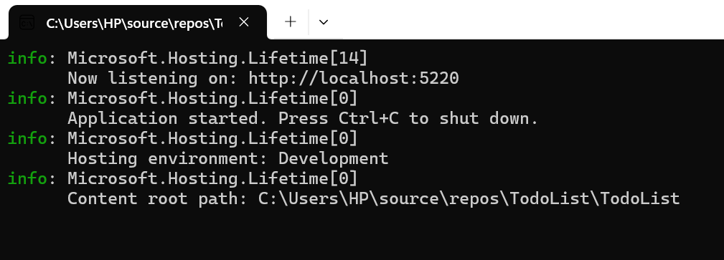
Build a simple Todo list with Blazor - 8
Run Blazor App

Slide 25
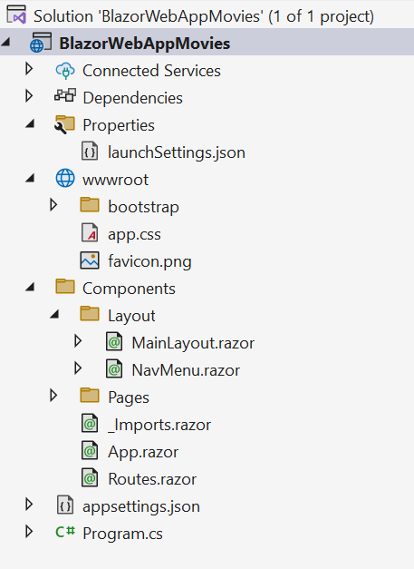
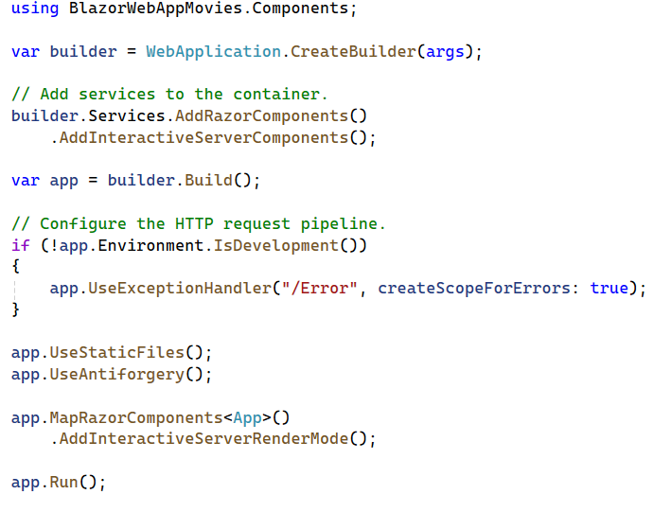
Build a Blazor movie database app - 1
Select Blazor Web App from the list of project templates..
Create a project named BlazorWebAppMovies

Slide 26
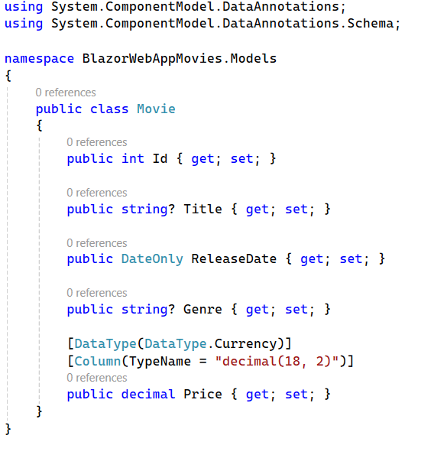
Build a Blazor movie database app - 2
Create Movie model class

Slide 27
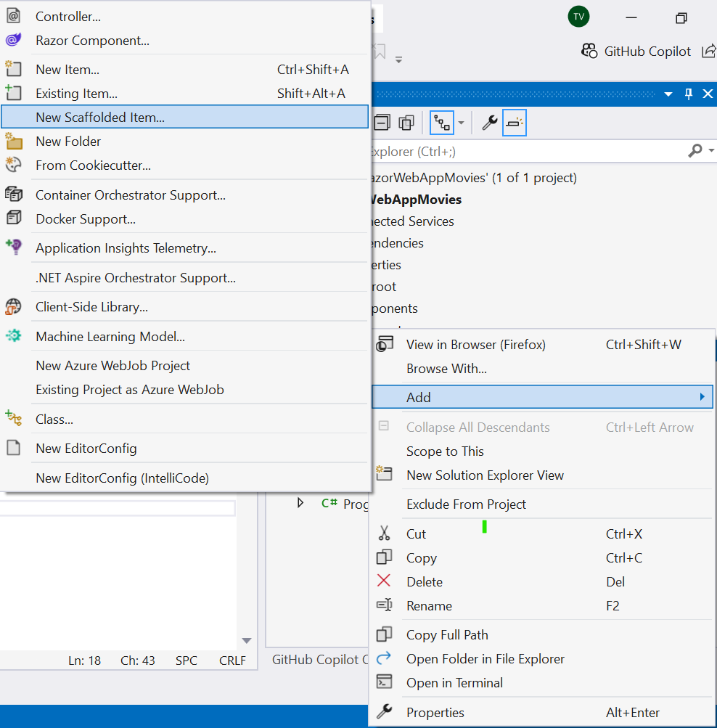
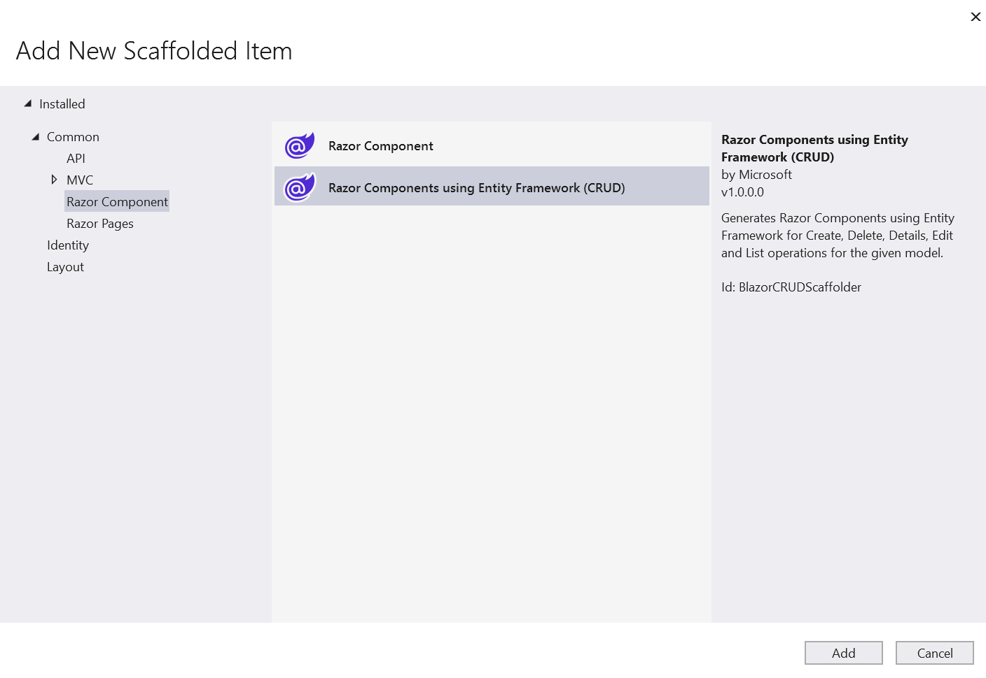
Build a Blazor movie database app - 3
Add New Scaffolded Item

Slide 28
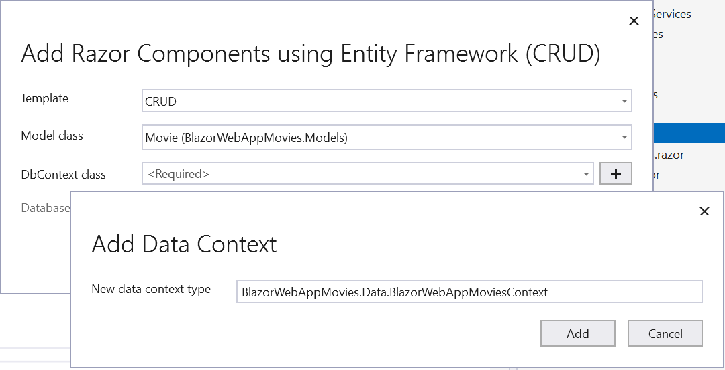
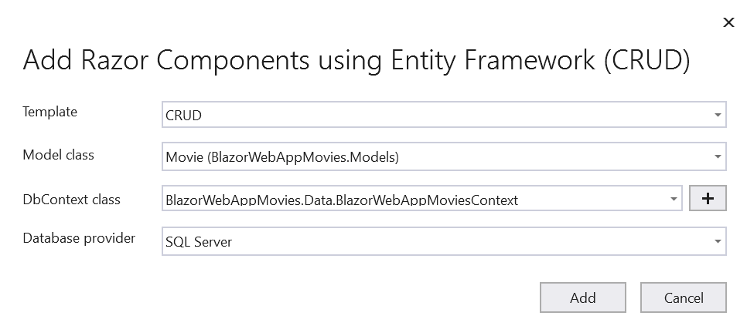
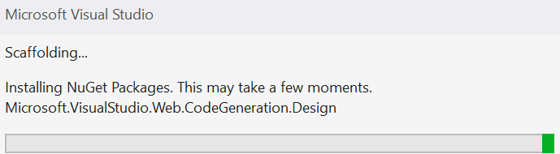
Build a Blazor movie database app - 4
Add Razor Components using Entity Framework (CRUD)

Slide 29
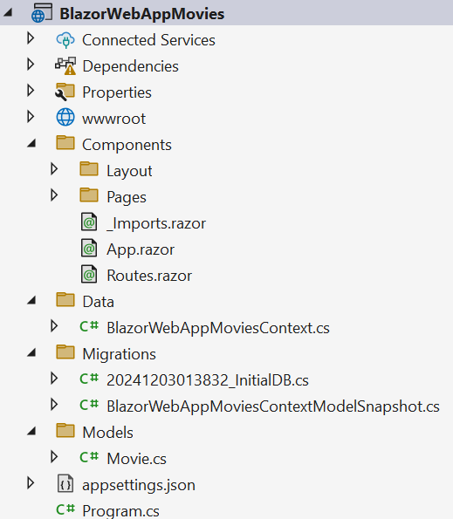
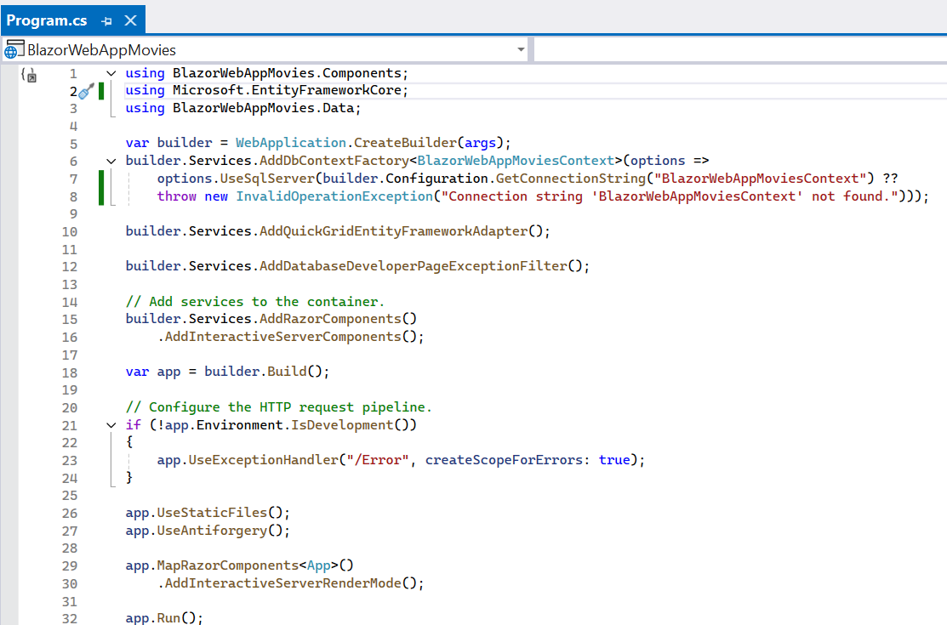
Build a Blazor movie database app - 5
Code generated in Program.cs

Slide 30
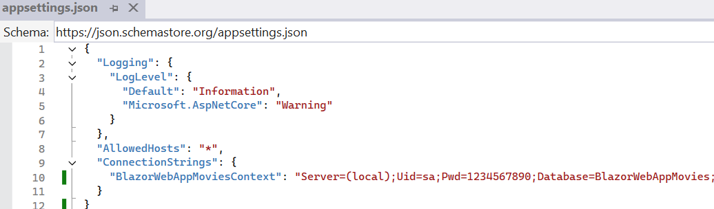
Build a Blazor movie database app - 6
Change the Connection string in appsettings.json
dotnet ef migrations add “InitialDB”
dotnet ef database update

Slide 31
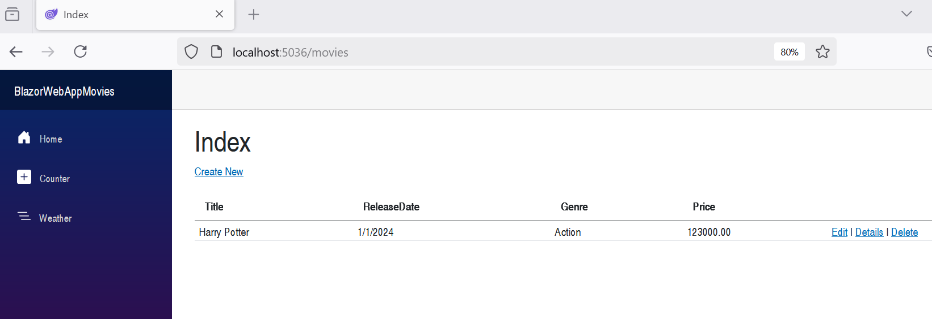
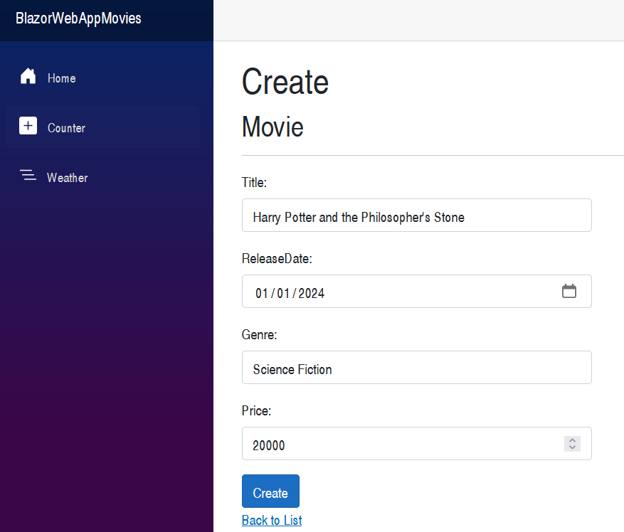
Build a Blazor movie database app - 7
Run the Blazor Web App with CRUD - Movie

Slide 32
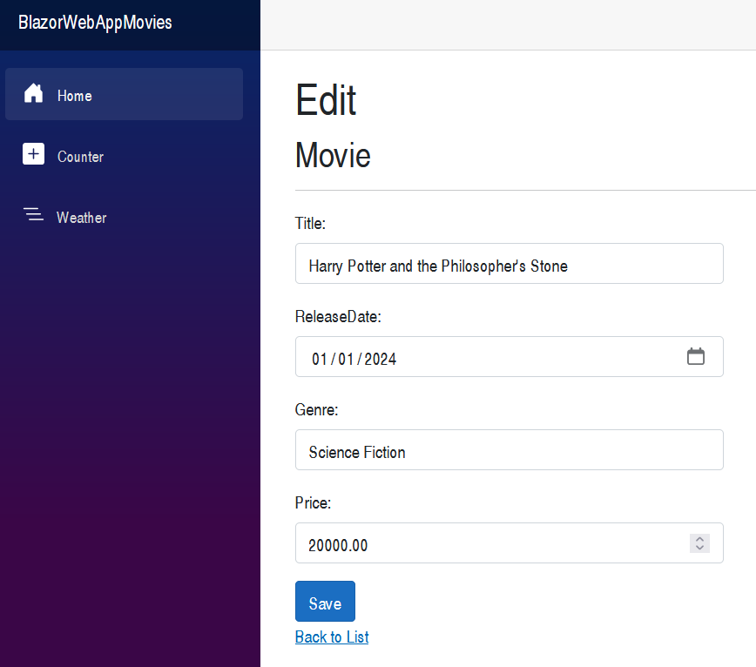
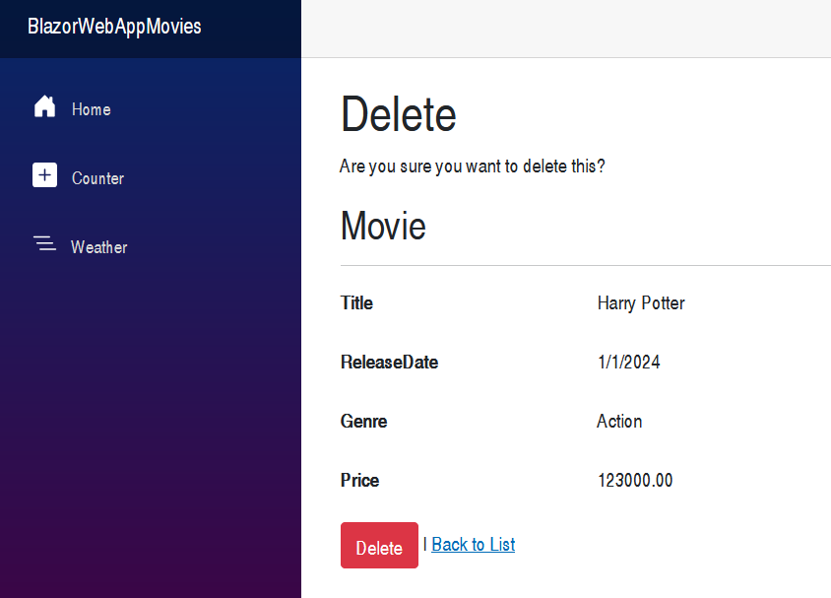
Build a Blazor movie database app - 8

Slide 33
Summary
Concepts were introduced:
ASP.NET Core with Blazor
Key Features
Blazor Component
Blazor Hosting Models Comparison
Build a Blazor Web App
Build a Blazor Web App with Entity Framework Core

